Slide 1

Practice of Social Media Analytics 1# Homework

Slide 2


Editor
I am Jennifer Liao.
Major : Industrial Management
Student ID. : M10401003
Email : lenter0218@yahoo.com.tw

Slide 3

Part I.
Construct my own container in docker

Slide 4
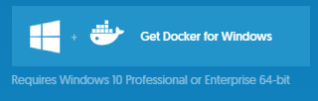
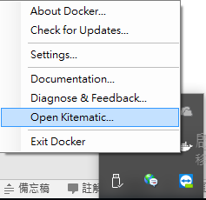
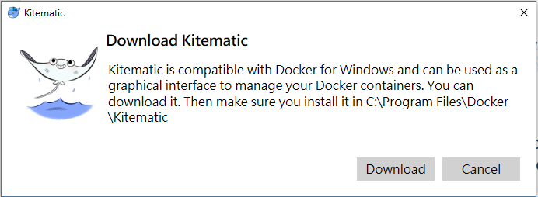
Operating system : Window 10 pro 64bit
Analytics platform : Docker for windows
a.
b. Installation steps
1. Download and install the docker for windows from docker website https://www.docker.com/
2. Download the Kitematic

Slide 5
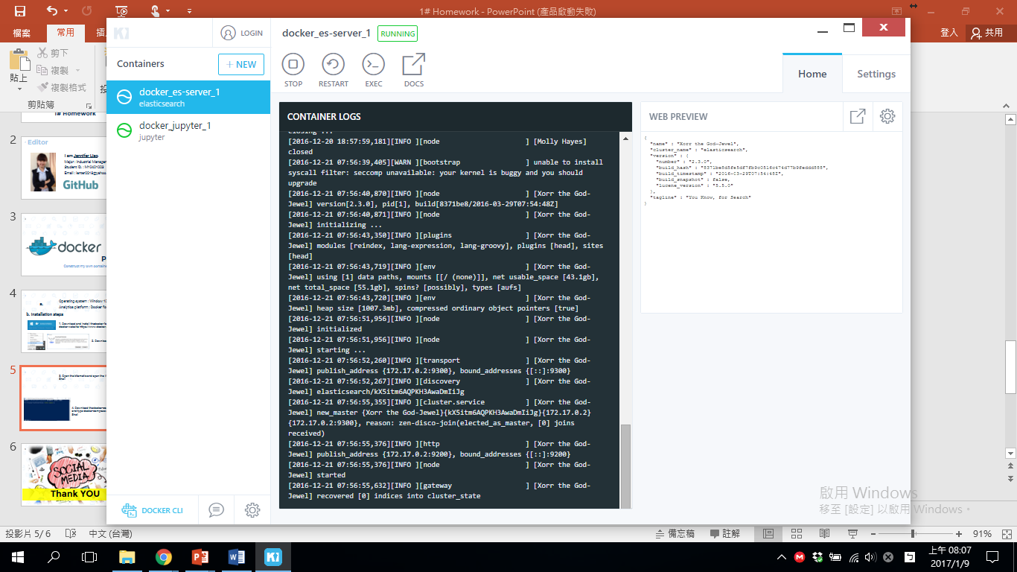
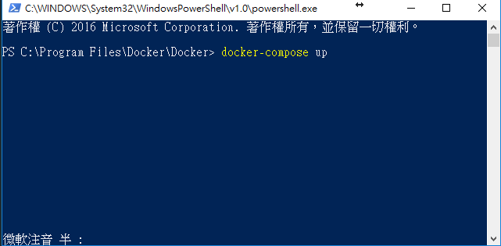
3. Open the kitematic and open the Windows Power Shell
4. Download the docker-compose.yml file and type docker-compose up in Power Shell

Slide 6
Only install two container
1. Jupyter notebook
2. ElasticSearch
對於Docker不熟悉
不熟悉Power Shell之語法
但網路相關資源多，皆可以找到解決方法
The difficulties I met

Slide 7

Thank YOU

